Slide 1
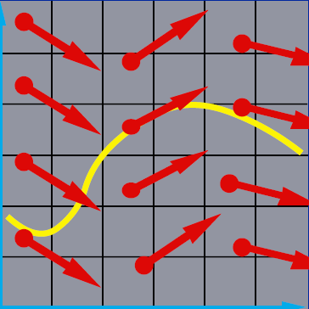
Numerical Solution of Ordinary Differentiation Equations
x₂
x₁

Slide 2
Differential Equations
Differential equation describes the relation between an unknown function and its derivatives
Solving a differential equation is to find a function that satisfies the relation
Numerical solution of differential equations is based on finite-dimensional approximation

Slide 3
Ordinary Differential Equations
All derivatives are with respect to single independent variable, usually representing time
Known function
Unknown function that evaluates the state given time
Time derivative of the unknown function
*We’ll show that a higher ODE can be transformed into this 1st order system later!

Slide 4
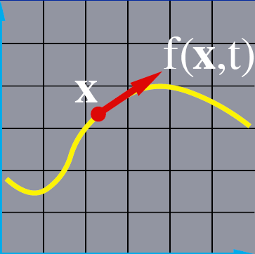
Visualizing Ordinary Differential Equation
x₂
x₁

Slide 5
Vector Field
The differential equation defines a vector field over x
x₂
Think of this vector field as the sea, and the velocity of current at different places and time is defined by f(x,t)
x₁

Slide 6
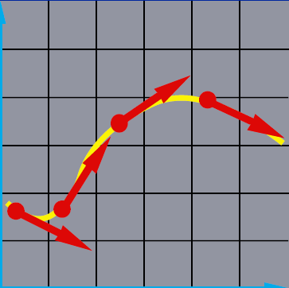
Integral Curves
Pick a starting point, and follow the vectors
x₂
Release a ball at any starting point and let it drift following the current. The trajectory swept out by the ball is an integral curve
x₁

Slide 7
Initial Value Problem
Given the starting point, follow the integral curve
x₂
Where the ball is carried depends on where we initially drop it, but once dropped, all future motion is determined by f(x,t)
x₁

Slide 8
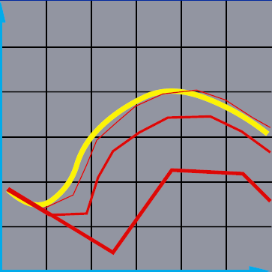
Numerical Solution of ODEs
Instead of true integral curve, numerical solution follow a polygonal path
Each leg is obtained by evaluating the derivative at discrete time steps
Bigger steps, bigger errors
x₂
x₁

Slide 9
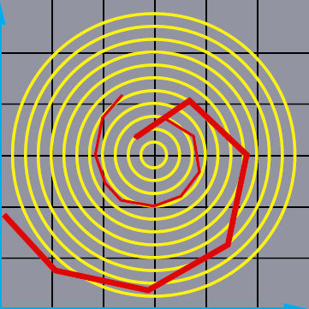
Problem I: Inaccuracy
Error turns x(t) from a circle into the spiral of your choice!
x₂
x₁

Slide 10
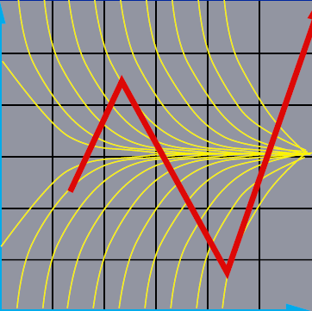
Problem II: Instability
x₂
x₁

Slide 11
Euler’s Method
Simplest numerical solution method
Bigger time steps, bigger errors
x₂
x₁

Slide 12
Euler’s Method (cont.)
Solves ODE using one-term Taylor-series

Slide 13
Drawbacks of Euler’s Method
Inaccuracy
Inefficiency
Need to use small time-steps to avoid divergence
Example:
http://www.cs.illinois.edu/~heath/iem/ode/eulrmthd/
Improvement using the midpoint method
Slope at the midpoint is used

Slide 14
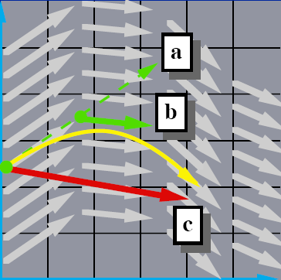
The Midpoint Method
Compute an Euler step
Evaluate f at the midpoint
Take a step using the midpoint value
x₂
x₁

Slide 15
The Midpoint Method (cont.)
Solves ODE using two-term Taylor-series
Approximating f’ by Taylor-series

Slide 16
Error of The Midpoint Method

Slide 17
Higher-Order ODEs
Order of ODE determined by the highest-order derivative of solution function appearing in ODE
Equations with higher derivatives can be transformed into equivalent first-order system

Slide 18
Higher-Order ODEs (cont.)
Given k-th order ODE
Define
Original ODE equivalent to first order system
…

Slide 19
Take Home Message
Visualization of ODE solution
Don’t use Euler’s method
Inaccuracy
Inefficiency (or unstable)
We’ll introduce other more stable methods
x₂
x₁

